Slide 1
Report of 2016
Diocese of Calgary Mission Council

Slide 2
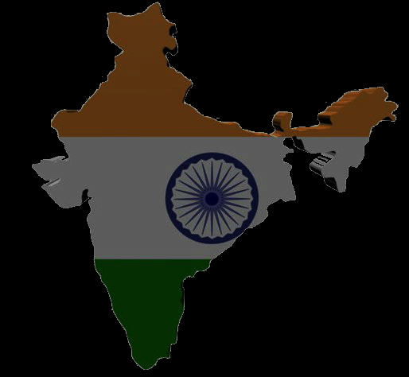
SAVE TRUST: Helping Mining Children for Education in India
Amaravathi Road, Nagaralu,
Guntur-522 034, (A.P.) S. India

Slide 3
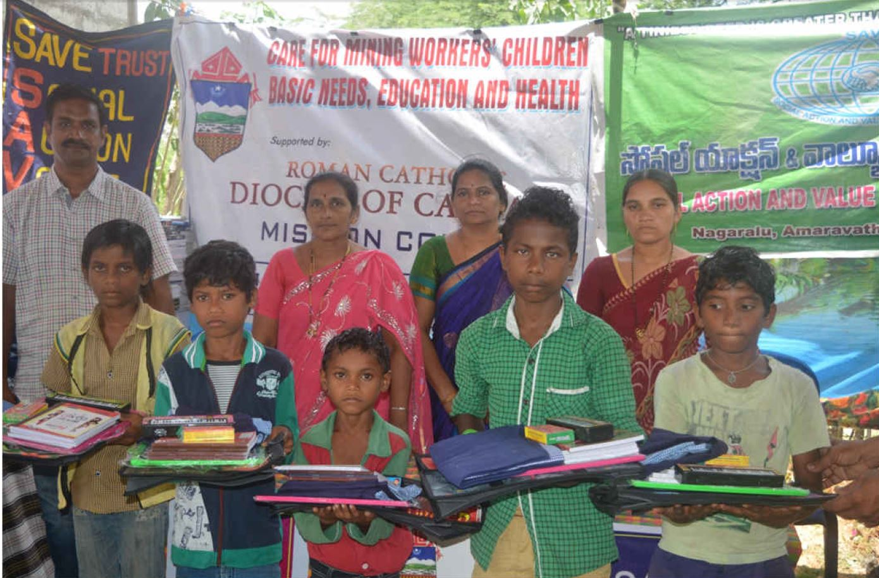
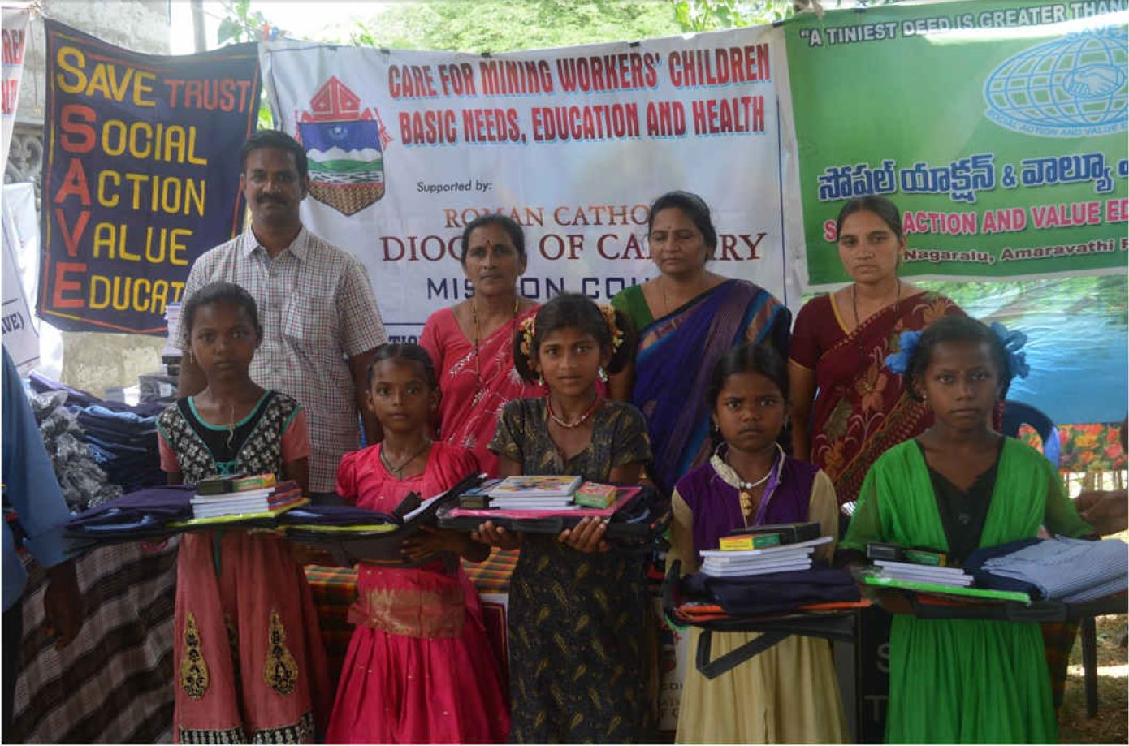
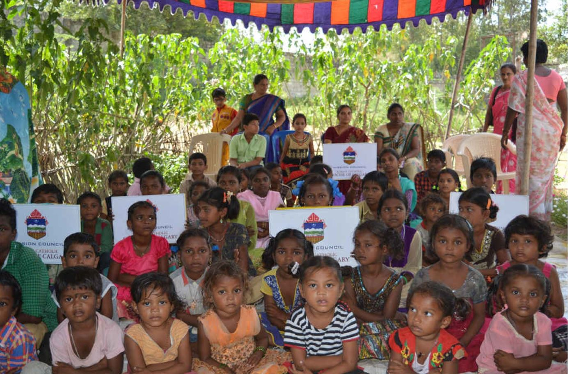
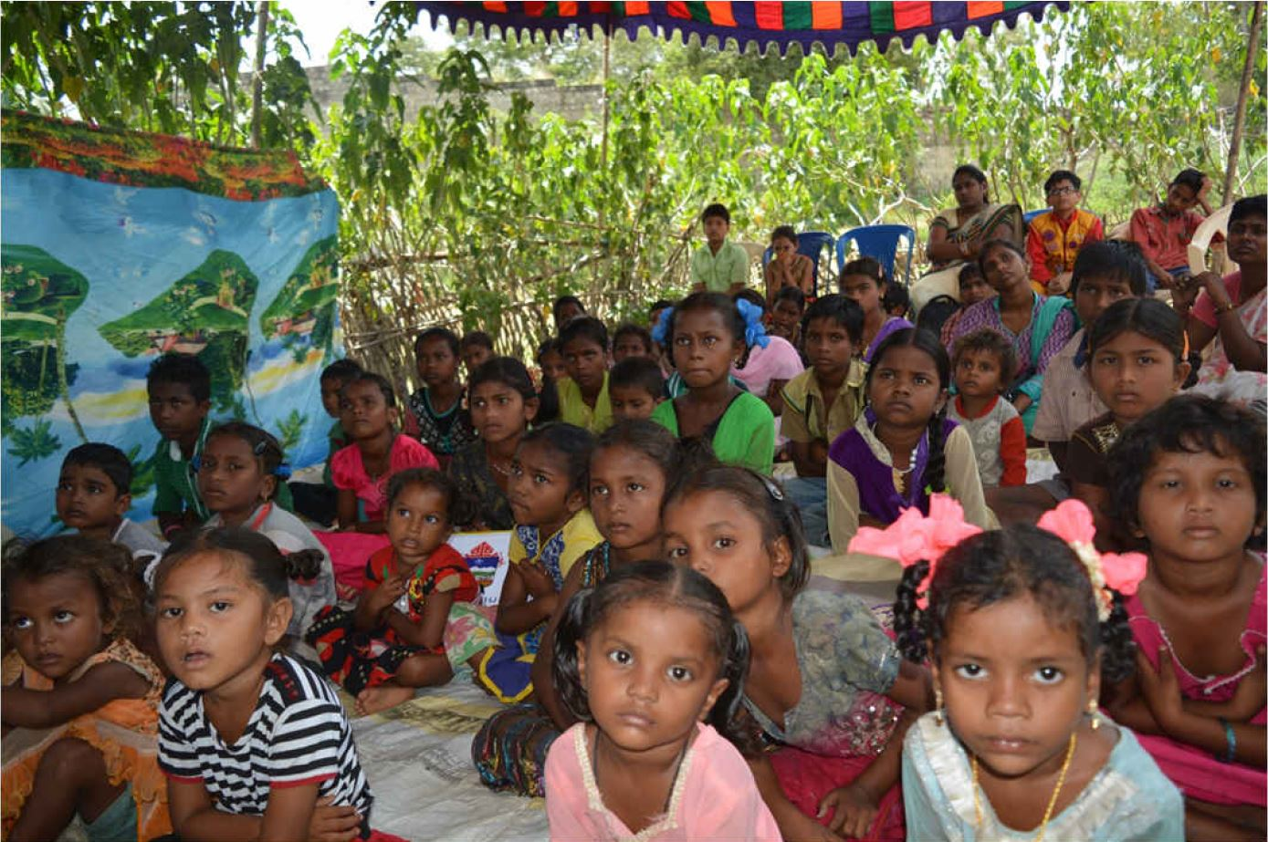
SAVE TRUST: Helping Mining Children for Education in India

Slide 4
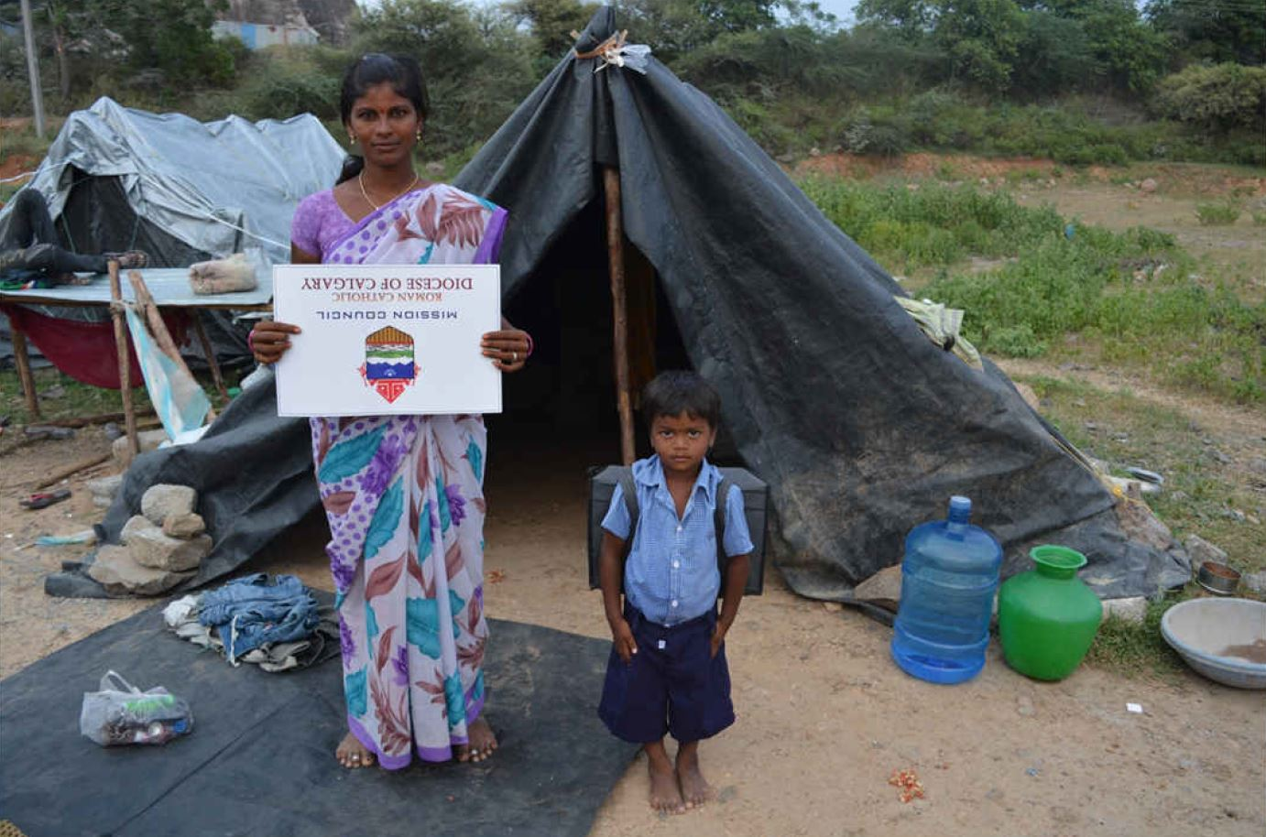
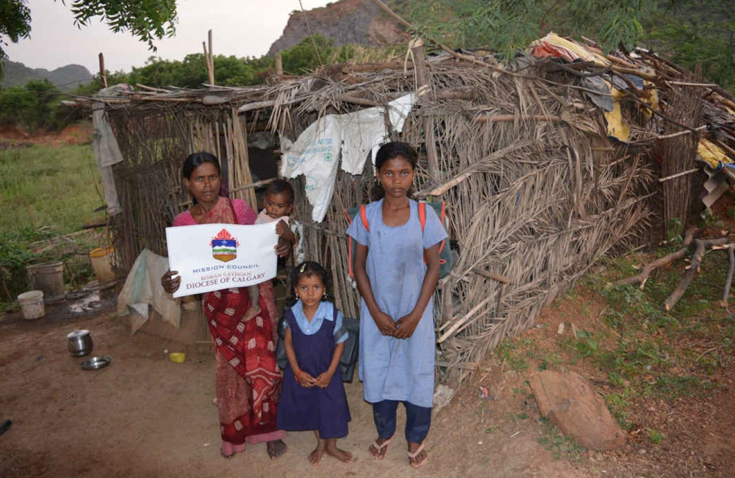
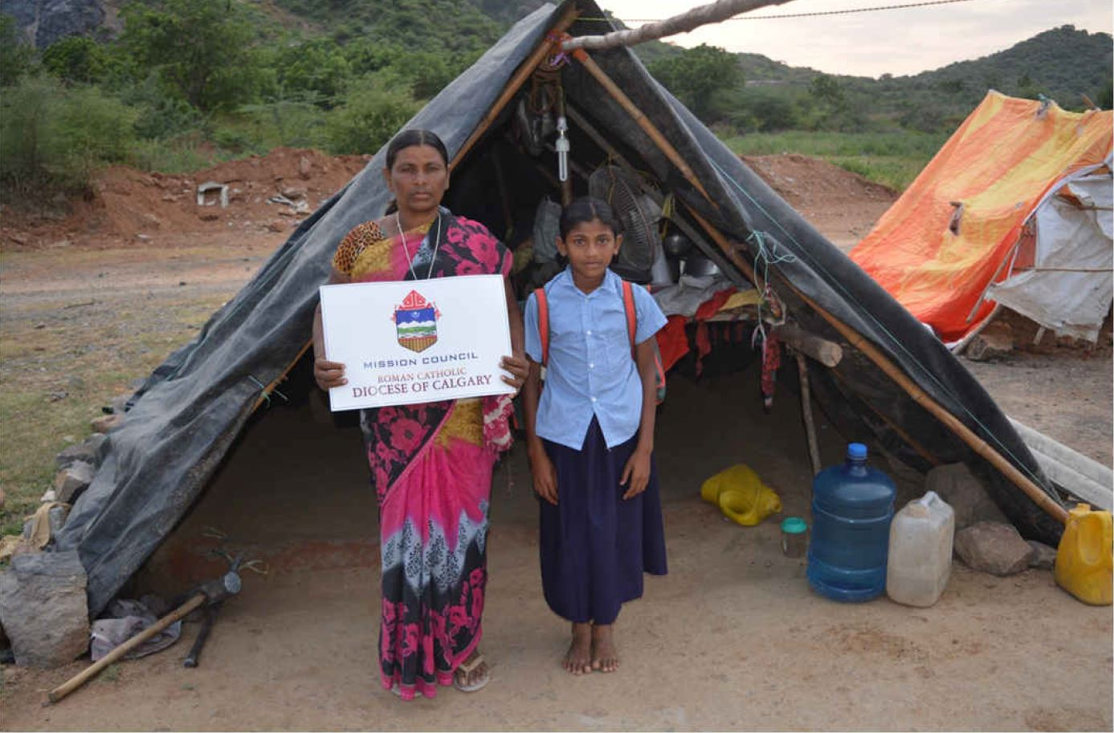
SAVE TRUST: Helping Mining Children for Education in India

Slide 5
MULTIPURPOSE SOCIAL SERVICE SOCIETY OF CUDDAPAH DIOCESE VOCATIONAL SKILL TRAINING IN TAILORING AND EMBROIDERY
Mariapuram-Cuddapah-3.A.P. India

Slide 6
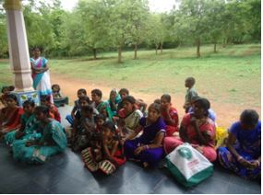
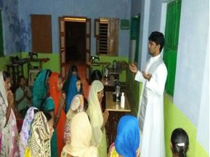
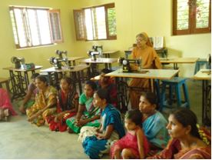
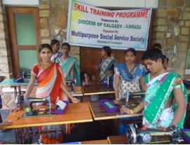
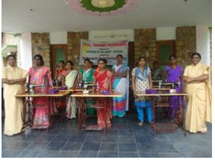
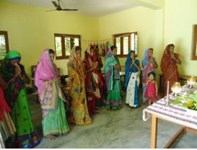
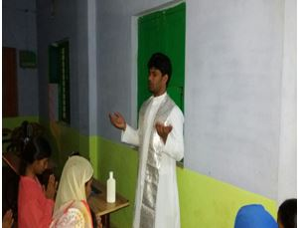
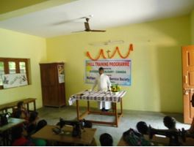
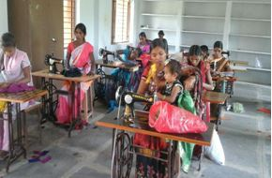
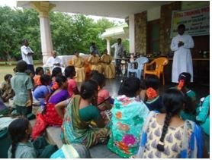
MULTIPURPOSE SOCIAL SERVICE SOCIETY OF CUDDAPAH DIOCESE VOCATIONAL SKILL TRAINING INTAILERING AND EMBROIDERY

Slide 7
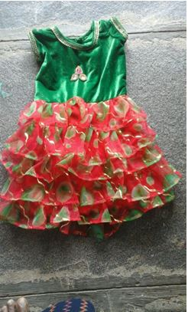
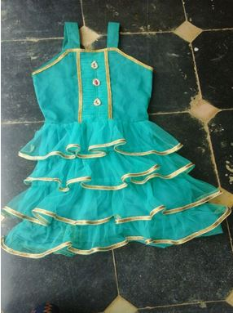
MULTIPURPOSE SOCIAL SERVICE SOCIETY OF CUDDAPAH DIOCESE VOCATIONAL SKILL TRAINING INTAILERING AND EMBROIDERY

Slide 8
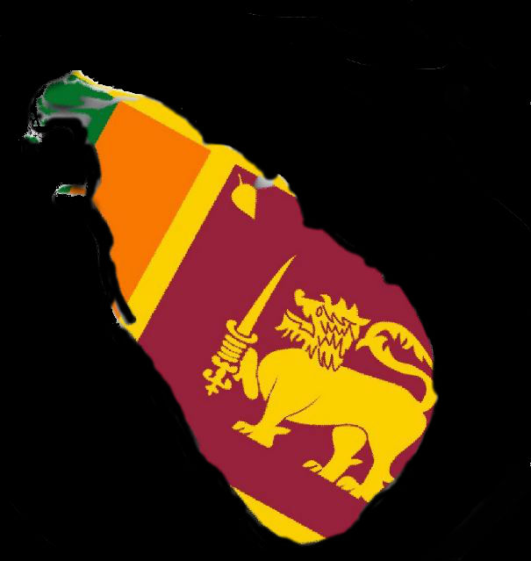
HAPPY LIFE: Social Development Foundation in Sri Lanka
34/1 Loluwagoda
Mirigama, Sri Lanka

Slide 9
1. Drug Prevention and Awareness Programs for School Children.
No of Programs: 20
N0 of Participants: 2,951
No of Schools : 20
Money Spent: RS 364,560.00

Slide 10
1. Drug Prevention and Awareness Programs for School Children.
Bills: Attached
School children between ages(12-16)
25 Schools in the area was chosen
All the principals from the 25 schools were given a presentation about the program.
After the presentation permission was granted by 20 principals to carry our the one hour program during school time as we requested.
A special segment on alcohol abuse and smoking addictions also was included.

Slide 11
2. Practical Leadership Skills Development Program
No of Programs: 10
N0 of Participants: 1,226
Money Spent: RS 143,210.00
Bills: Attached

Slide 12
2. Practical Leadership Skills Development Program
Team activities: Children who miss out in school to lead get a chance to take a leadership role. Teams are divided and given small tasks to achieve.
Effective and fearless communication: The leader of the team has to come forward and share the task with the rest. Team members join in and describe how and in what way it was achieved.

Slide 13
2. Practical Leadership Skills Development Program
Negotiating skills: When other group often counter methods of achieving those tasks and better ways the team must prove that why that their methods were better. No one is encouraged to criticise each other but to offer best possible alternatives of solving tasks.
Family time: All children are given a task to get the family members together in the evenings after their parents return home after work. A small prayer time to thank and to have game time.

Slide 14
2. Practical Leadership Skills Development Program
Reading: To reduce the TV time for a day starting from 5 minutes a day and put that time into reading whatever they like. Do not need a book but at least a paragraph from a newspaper or a magazine. Introducing about the rich history of the country and leaders.
Money management: The importance of saving money even how to educate their parents on cutting costs.

Slide 15
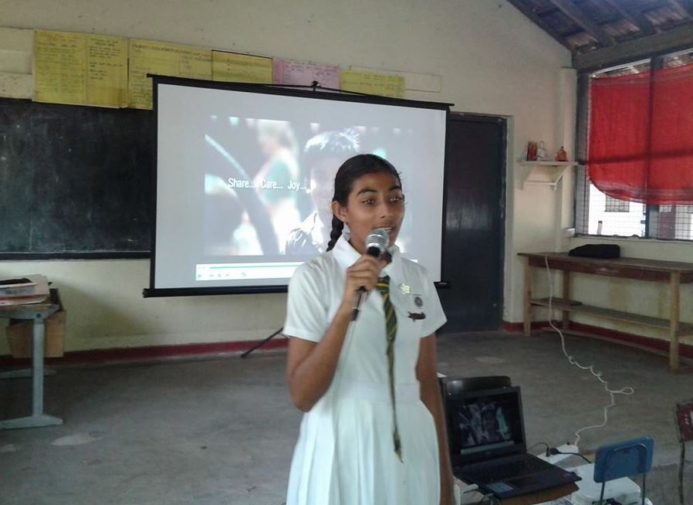
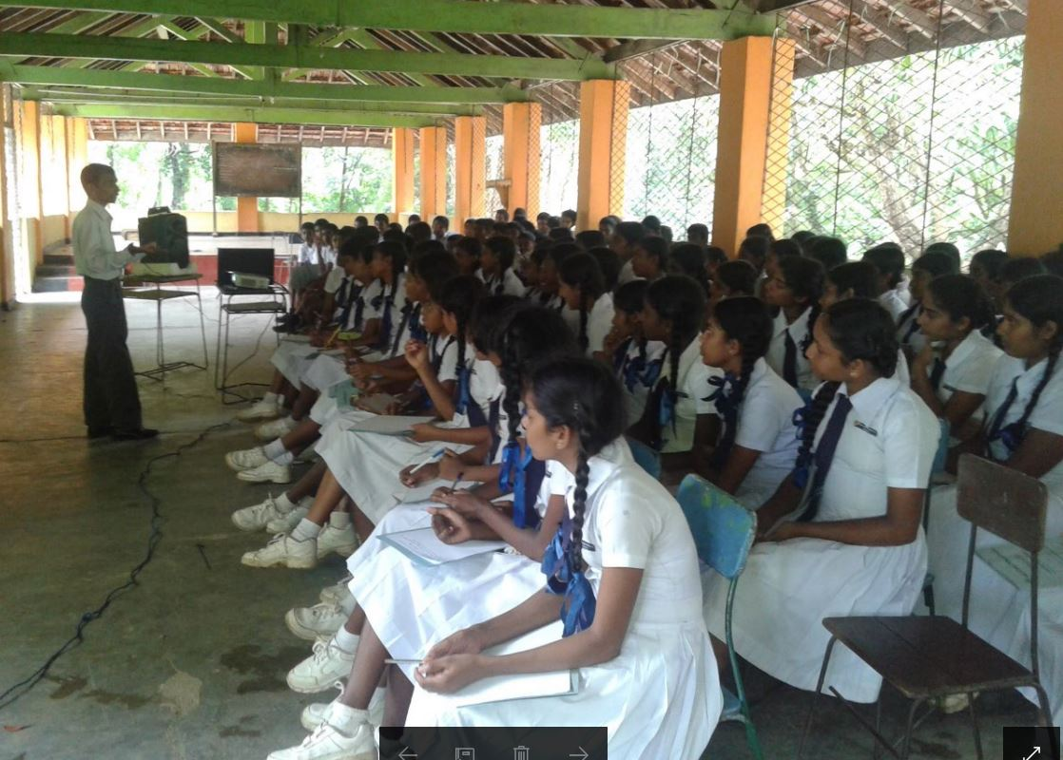
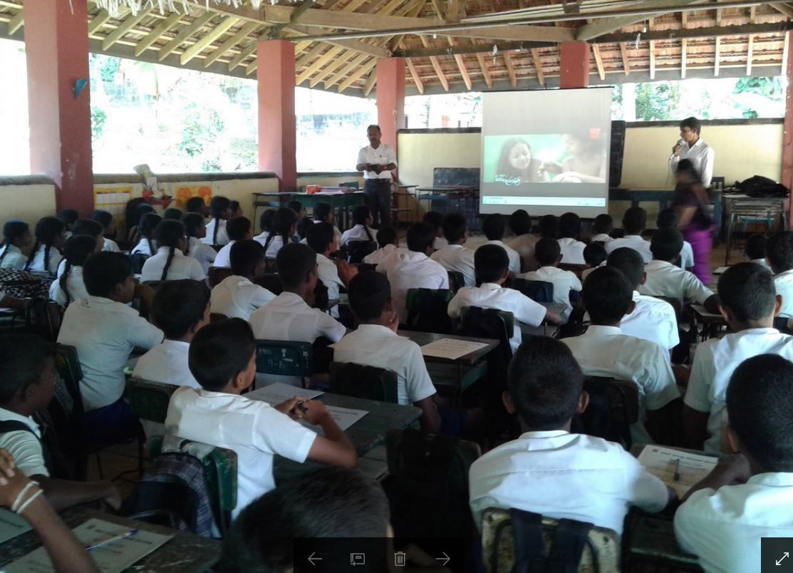
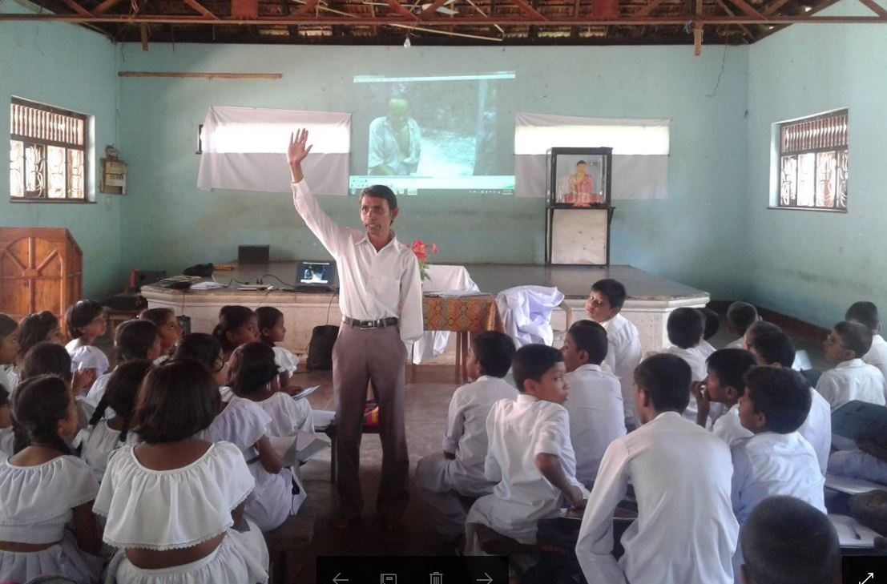
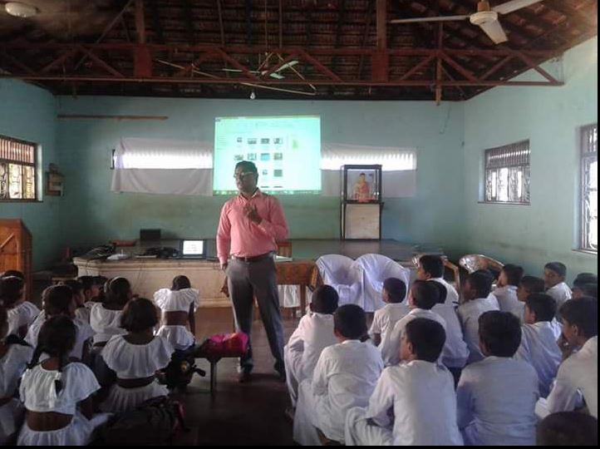
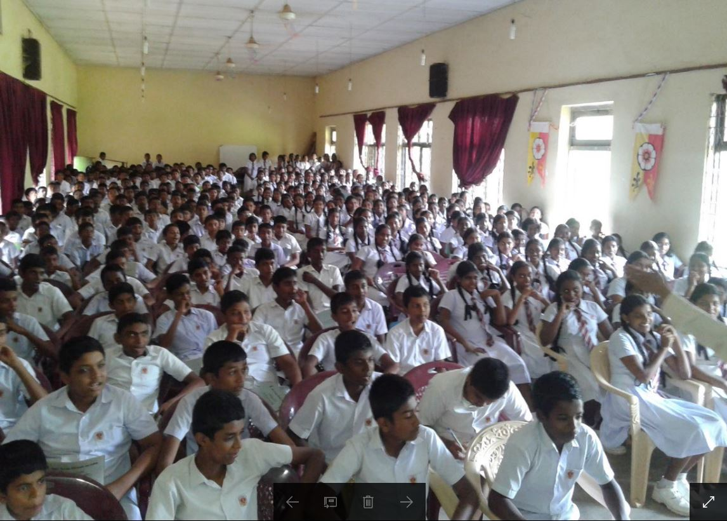
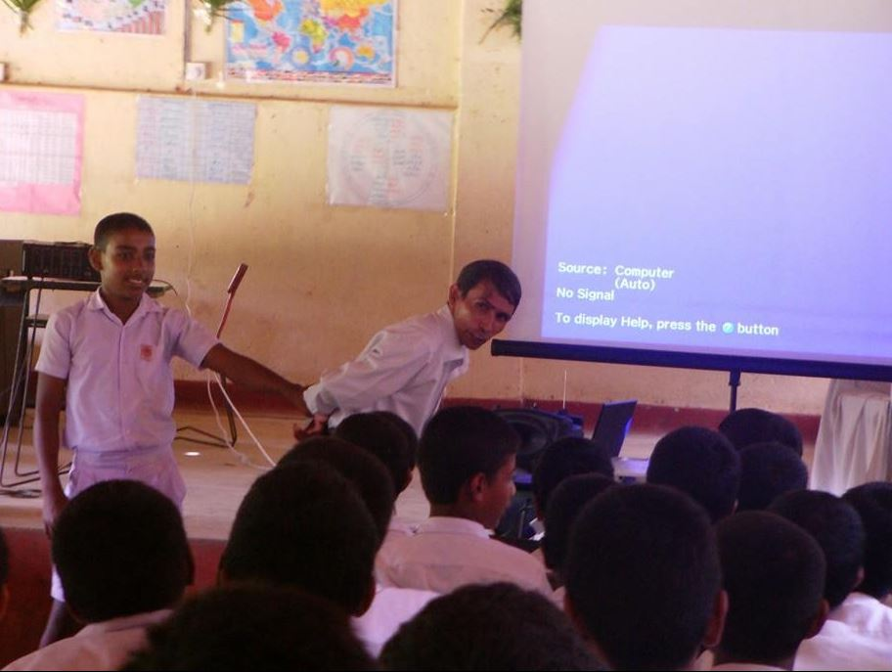
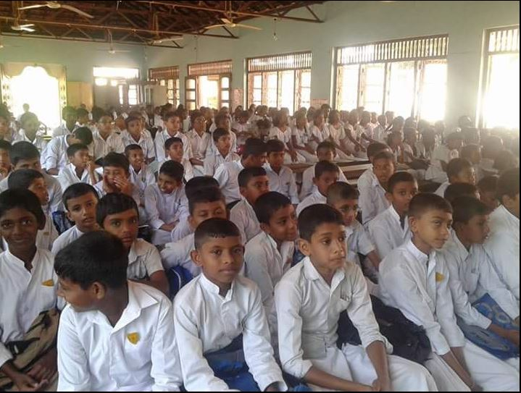
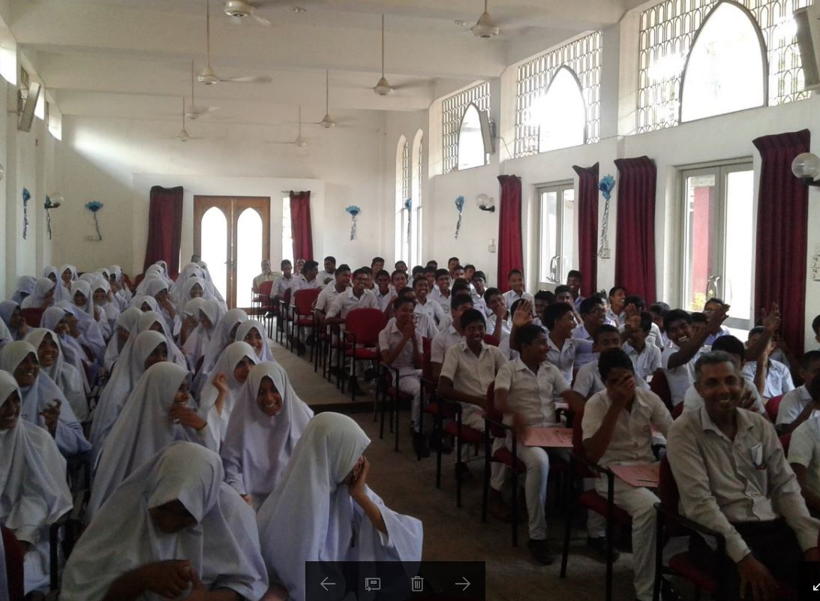

Slide 16
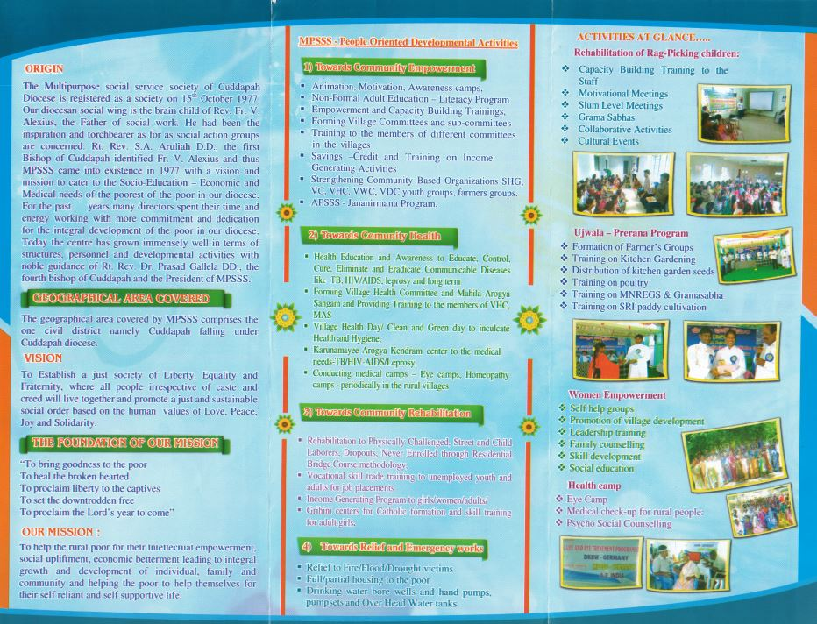
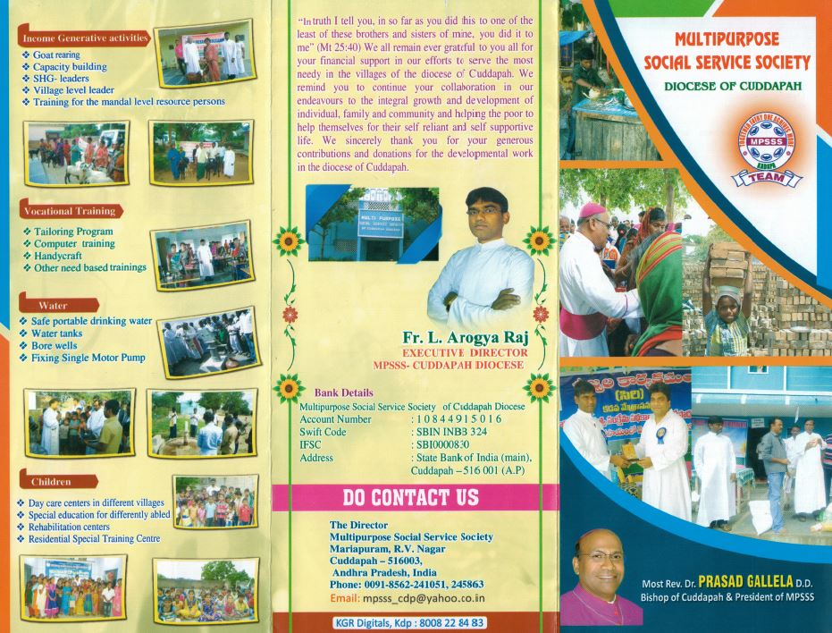

Slide 17
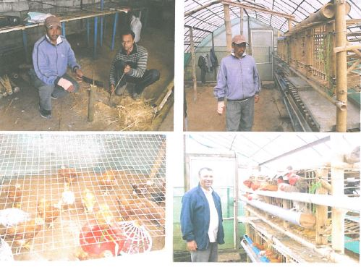
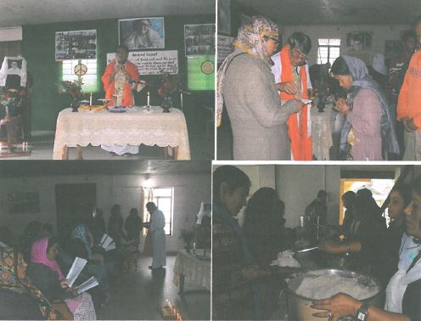
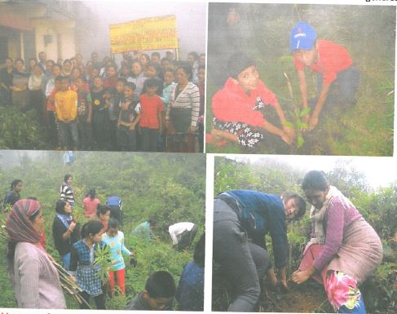
DARJEELING JESUIT PROVINCE

Slide 18
CATHOLIC EPARCHY OF KEREN – ERITREA CHURCH CONSTRUCTION IN HAMEDEY

Slide 19
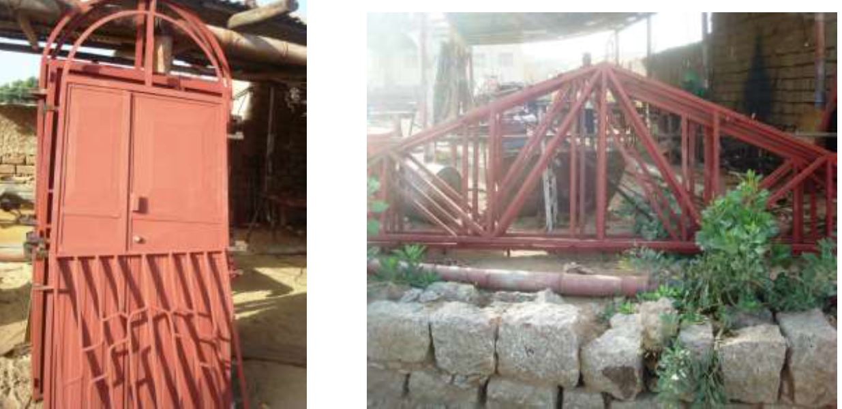
Metal work in the workshop place, ready to be transported to Hamedey

Slide 20
Sand and stone collection

Slide 21
UNIVERSITÉ NOTRE-DAME DU KASAYI RD DU CONGO​ FURNITURE FOR CHAPEL

Slide 22
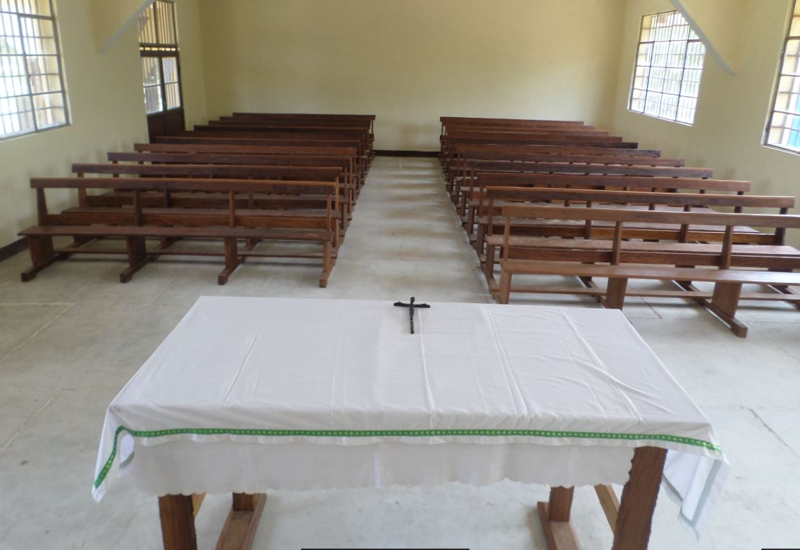
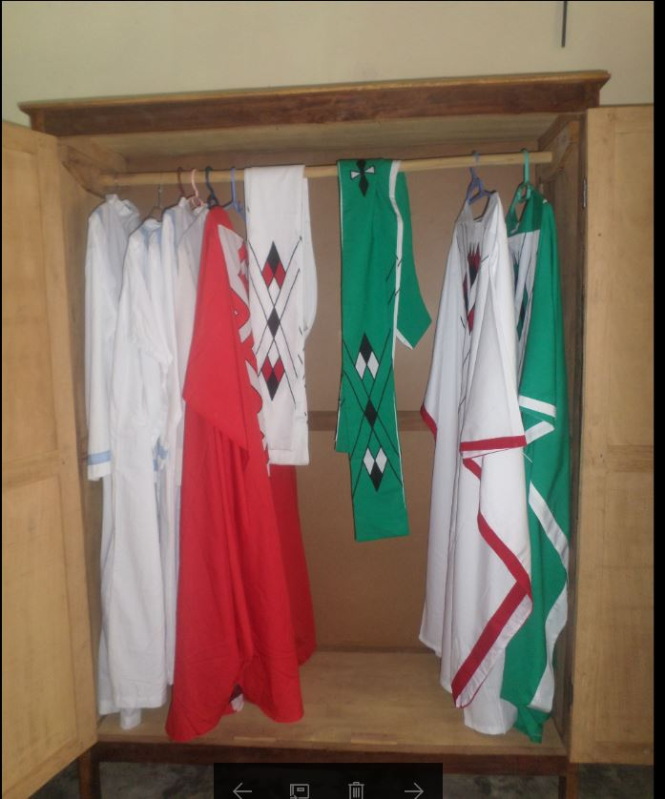
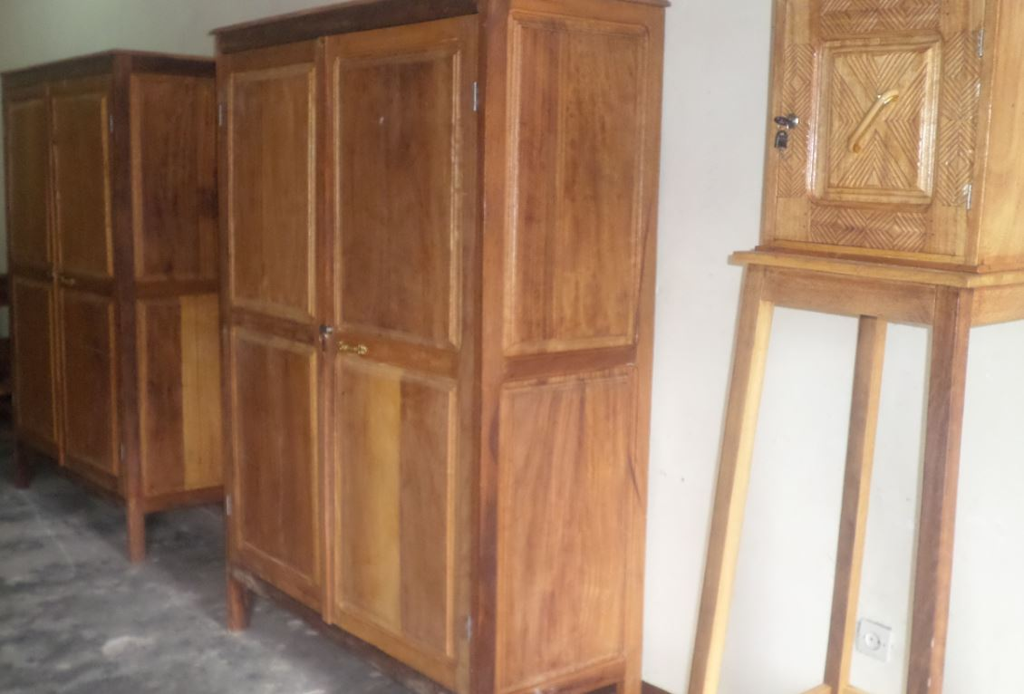
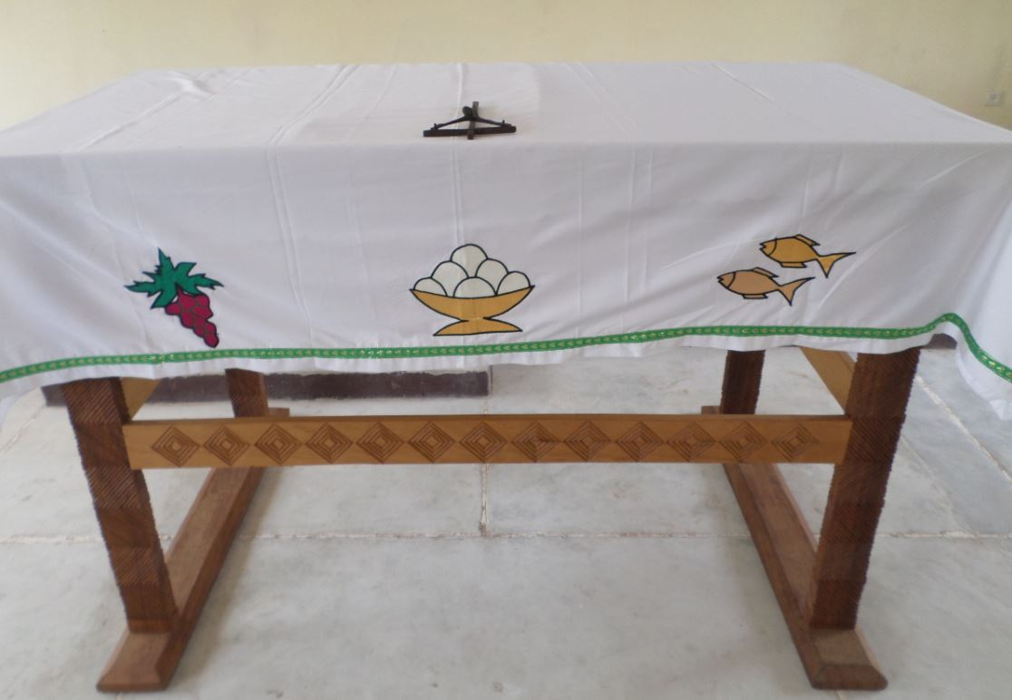
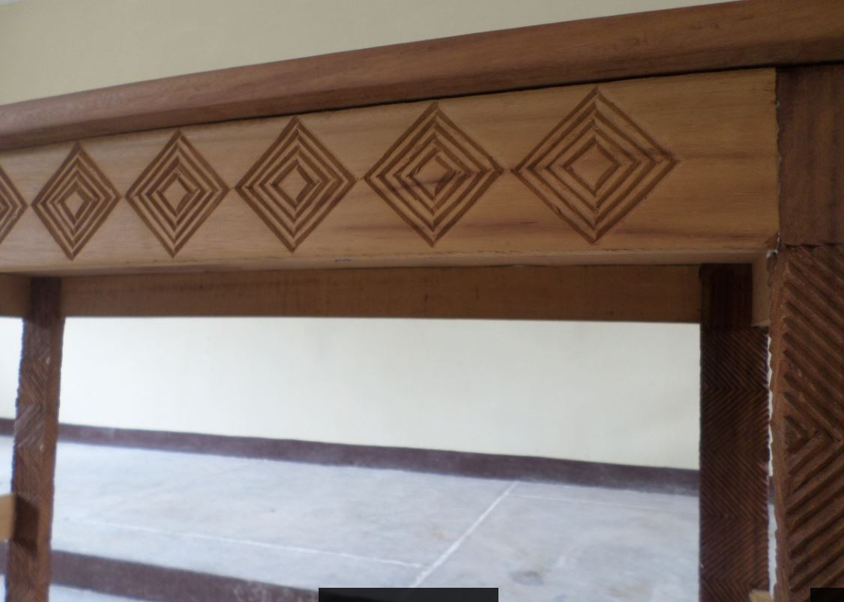
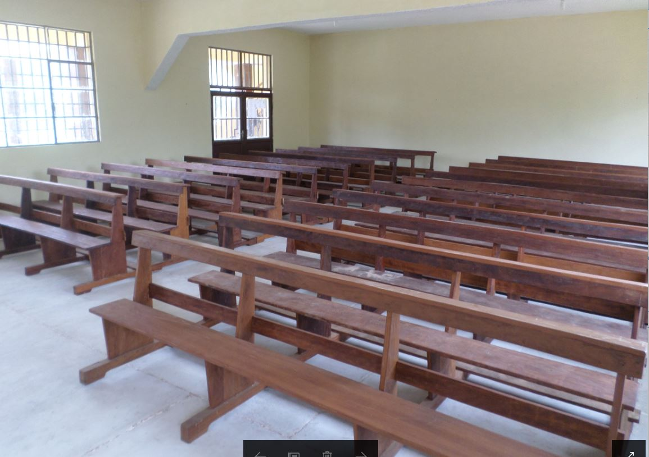
UNIVERSITÉ NOTRE-DAME DU KASAYI RD DU CONGO​ FURNITURE FOR CHAPEL

Slide 23
INDIA: Vellore Diocese​
Codep-Chetpet – 606801
Carpentry Tools for the Vocational Training to the Young Boys.
Provided 40 set of Tools.

Slide 24
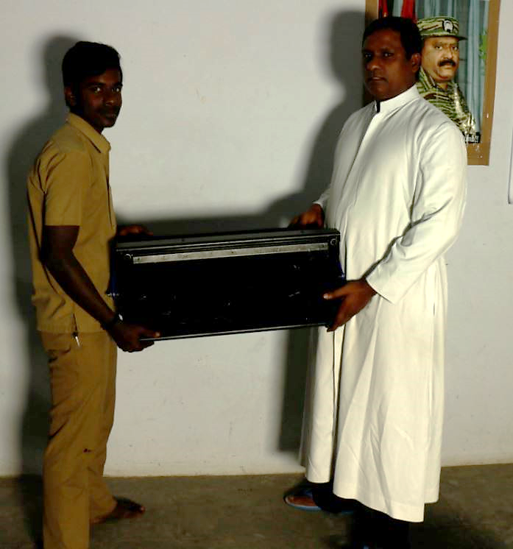
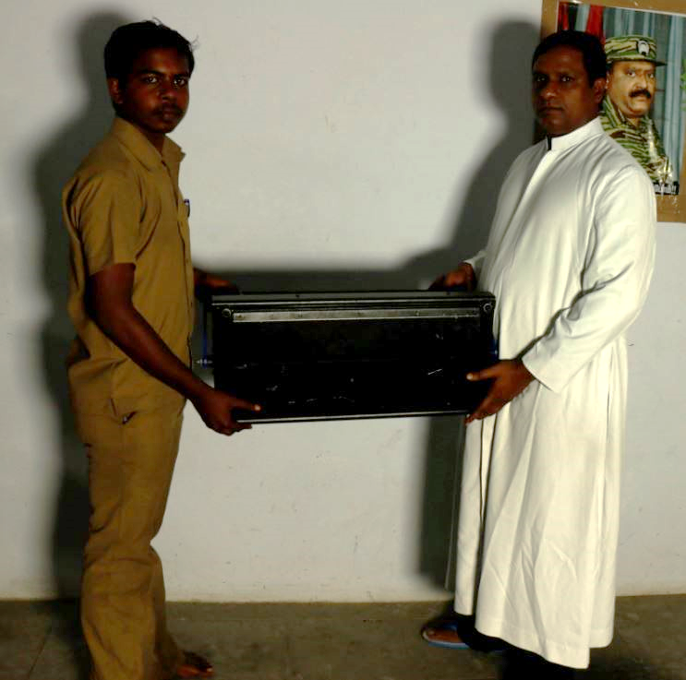
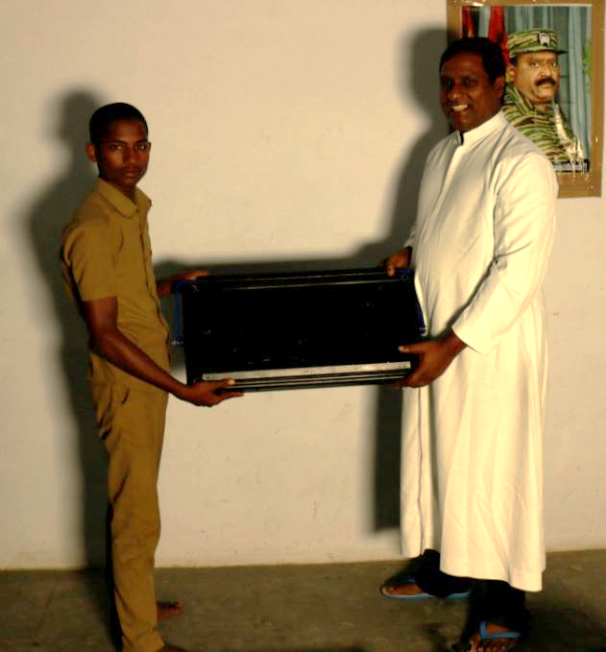
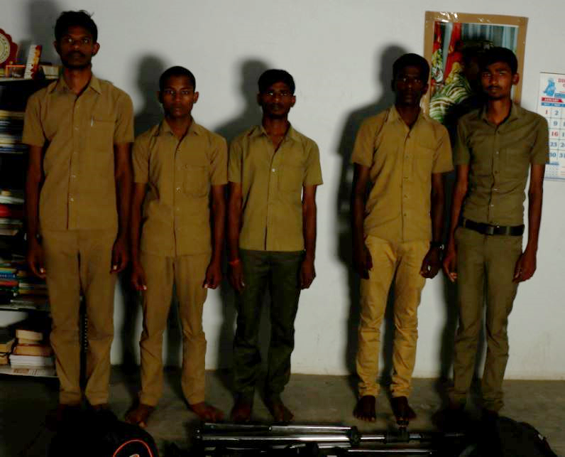
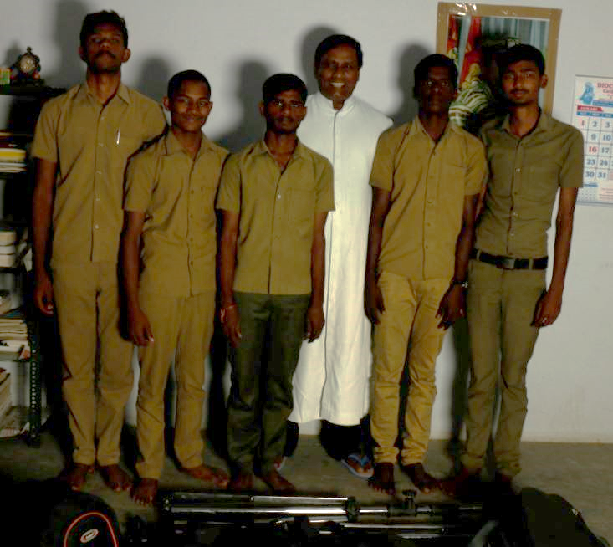
INDIA: Vellore Diocese​

