Slide 1
CCCRS ANNUAL GENERAL MEETING NOVEMBER 28, 2020

Slide 2
Welcome Note Deacon Alex Martinez Lievano

Slide 3
INTRODUCTIONS

Slide 4
Board of Directors: Co-Chairperson – Deacon Alex Martinez Lievano Co-Chairperson – Peter Thompson Co-Treasurer – Joyce Simoes Co-Treasurer/Secretary – Maxima Arat

Slide 5
CORE GROUP MEMBERS

Slide 6
Anthony Banka Beata Banka Kim Jakobowski Charleen Thoreson Tomas Kmet Dick Simoes

Slide 7
PRAYER GROUP LEADERS

Slide 8
Ark of the New Covenant Prayer Group St Joseph Roman Catholic Church 640 19 Ave NW, Calgary For more information, contact: Anthony Banka ajgardzi@shaw.ca

Slide 9
Divine Shepherd Charismatic Prayer Group St Thomas More Roman Catholic Church 15 Templebow Rd NE, Calgary Sunitha D’Cunha: divineshepherdgroup@gmail.com Fr. Jerald D’Souza – Spiritual Director

Slide 10
Divine Spirit Prayer Group Mary, Mother of the Redeemer Roman Catholic Church 714 14 Ave NE, Calgary Joyce & Dick Simoes (403-770-0250) email at joycesimoesjmj@gmail.com Fr. Shibu Spiritual Director

Slide 11
El Shaddai Calgary Chapter 1717 5th St.SW. Calgary Every Sunday at St. Famille Church 2:00pm – 5:00pm For more information, contact: Julie Gamban (403-630-8193) julie.gamban@hotmail.com Amy Alviar (403-714-8095) amelia_alviar@hotmail.com

Slide 12
El Shaddai Calgary Cell Group Every Saturday at St. Anthony Church 5340 – 4 Street SW Calgary For more information, contact: Pat Blas (403-607-0368) patricia_may17@yahoo.com Dolce Segura (403-390-7985) j_dulce999@yahoo.ca

Slide 13
Mary Mother of the Redeemer Prayer Group (Spanish) 1714 14 Ave NE, Calgary. Every Friday (except 2nd Friday of each month) From 7:00 pm to 9:00 pm Carlos Osorio -Chair Person (403-554-0597) carlos.0sorio@yahoo.com Gustavo Escudero – Co-Chairman(403-918-1603) Fr. Shibu Spiritual Director

Slide 14
Maranatha Prayer Group St Bonaventure Roman Catholic Church 1600 Acadia Dr. SE, Calgary For more information, contact: Peter Thompson peter4god@shaw.ca Tomas Kmet tomas.kmet@igprivatewealth.com

Slide 15
Nigerian Community Our Lady Queen of Peace Church 2111 Uxbridge Dr. NW, Calgary Group is currently meeting on Tuesdays and Fridays Time : 7:30pm – 8:45pm For more information contact: Nduka Ezechukwu (403-605-5006) bethuel.nduka@yahoo.ca

Slide 16
OSG YYC (Open in Spirit to God / Bukas Loob sa Diyos) ​​​Ascension Roman Catholic Church 1100 Berkshire Blvd NW Calgary, AB T3K 3M3 The group is meeting every 2nd and 4th Fridays of each month via a web conferencing platform called Webex. It starts with Rosary at 7:00 PM. For more information contact: Amparito Landeta 403-879-7784 info@OSGCalgary.com Spiritual Director: Fr. Avinash Colaco

Slide 17
Rivers of Living Water Charismatic Prayer Group St. James Roman Catholic Church 338040 32 St E, Okotoks For more information Kim Jakobowski, email: rolwinfo@shaw.ca Due to the current pandemic, meetings are temporarily suspended.

Slide 18
Rushing Wind Young Adult Prayer Group (Ages 18-40) St. Peter’s church 541 Silvergrove Dr. NW, Calgary If you are interested in joining this group, please contact Shane for more information at rushingwind@st-peters.ca

Slide 19
St Luke’s Prayer Group St. Luke’s Roman Catholic Church 1566 Northmount Drive NW, Calgary For more information, contact: Charlene Thorson (403-239- 0588) cthorson@telusplanet.net Due to the current pandemic, meetings are temporarily suspended.

Slide 20
COUPLES FOR CHRIST Contact information of the prayer group leader: Manny Canete- Area Head of Calgary; Phone: 403-512-2785 or Email: emmanuel_canete@yahoo.com Fr. Vincent Ha- Spiritual Director Pastor of St. James Parish in Okotoks

Slide 21
SUMMARY OF PAST EVENTS November 2019- November 2020

Slide 22
1. Prayer Breakfast – (February 1, 2020, Holy Spirit Parish) 2. 20 Consecutive Nights Virtual Prayer Meetings April 12 to May 1, 2020 3. Virtual Novena to the Holy Spirit – (May 22 to 30, 2020) 4. Virtual Feast of Pentecost Celebration – (May 31, 2020) 5. Diocesan Lay Association Meetings (2 meetings)

Slide 23
6. Virtual Prayer Breakfast – (September 12, 2020) 7. Virtual Mighty River Conference – October 16 & 17, 2020) 8. Virtual Leaders Conference Day – (October 18, 2020) 9. Virtual Discipleship, Growth and Formation in our Faith Discovering my Divine Mission - (November 7, 2020) Growth in the Spirit - (November 21, 2020) My people perish for lack of knowledge, Go into the whole world.

Slide 24
FINANCIAL REPORT

Slide 25
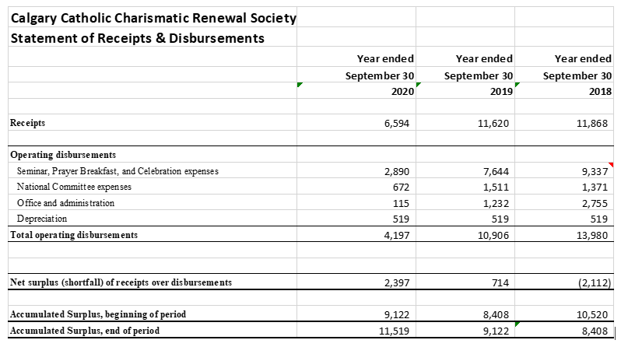

Slide 26
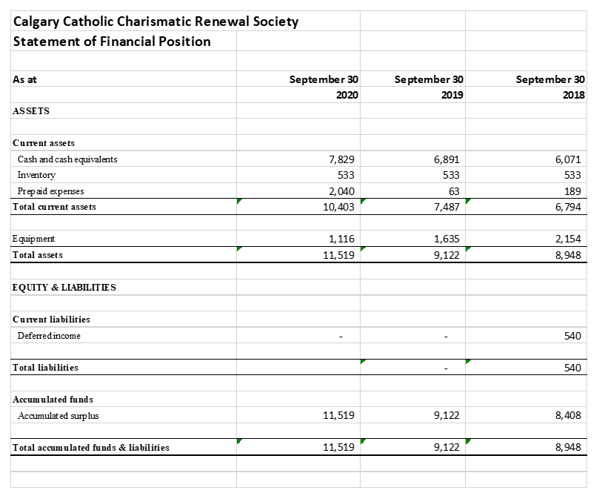

Slide 27
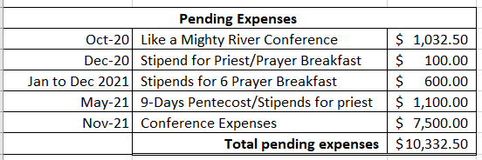

Slide 28
CCCRS New Events: Nov 2020 – Nov 2021

Slide 29
CCCRS: Calendar of events Discipleship, Growth and Formation in our Faith (December 5^{th,} 2020) Virtual Prayer Breakfast – (Dec 12, 2020) Fr. Julian Studden Pentecost Vigil - (May 22, 2021)

Slide 30
CCCRS: Calendar of events Annual CCCRS “ Like a Mighty River” Conference Leadership formation ( November 2021) Prayer Breakfast - Adoration of the Blessed Sacrament

Slide 31
CCCRS: Pending Events

Slide 32
CCCRS: Calendar of Pending Events Night Vigils – Pending Prayer Group Leaders Meeting – Pending July 31. Mass With Healing Services - Pending Life in the Spirit Seminars (Diocesan Wide LSS) Growth in the Charismas Retreats - Pending Meeting with Bishop McGrattan – Pending

Slide 33
Q&A

Slide 34
Announcements

